Slide 2
Pathfinder AI (Implementing path finding algorithms for route planning)
Minor Project Presentation
Submitted By:
Keertivallabh Sharma | R2142220539 | B.Tech CSE FSAI
Jyotiraditya Singh | R2142220530 | B.Tech CSE FSAI
Shrey Sharma | R2142220169 | B.Tech CSE FSAI
Rishav Singh | R2142220149 | B.Tech CSE FSAI
Mentored By: Dr. Panduranga Raviteja

Slide 3
Abstract
In a world where efficient infrastructure is the backbone of urban growth, smart route planning is essential for projects like national highways and inter-city roads. This project focuses on creating an interactive, user-friendly system that uses a modified version of Dijkstra’s algorithm to design optimal routes. Users can upload city maps, select cities for connection, and mark key locations like hospitals, offices, and airports. The system then computes the best route, balancing cost, accessibility, and efficiency, which is particularly relevant for developing countries like India. By providing visual feedback and flexible options for customizing routes, this tool helps planners and engineers visualize and refine construction paths more intuitively. Beyond immediate use, the project demonstrates the potential of new technologies in urban planning, contributing toward sustainable and smart city initiatives.

Slide 4
Introduction
As urbanization accelerates, efficient route planning for infrastructure projects, especially highways and inter-city roads, is crucial for connecting communities and driving economic growth. In developing regions like India, balancing cost, accessibility, and environmental impact in route planning is a significant challenge. This project introduces a user-friendly system that uses a modified Dijkstra’s algorithm to help users design optimized routes. By uploading city maps, selecting target cities, and marking key landmarks such as hospitals and transport hubs, users can generate and customize routes that address both practical and sustainable considerations. This project showcases how advanced algorithms can enhance urban planning, supporting smarter, more connected cities.
This version keeps the focus on the project’s purpose and broader impact while being more succinct. Let me know if this feels right!

Slide 5
.
Objectives
1. Develop an Interactive Route Planning Tool: Create a user-friendly platform that enables users to upload city maps, select target cities for connection, and mark key landmarks like hospitals, offices, and transport hubs.
2. Implement Modified Routing Algorithms: Design and integrate a modified version of Path finding algorithms that calculates optimal routes, considering factors like cost, accessibility, and efficiency in construction.
3. Balance Practical and Required Criteria: Ensure the algorithm balances key criteria, such as minimizing costs and improving accessibility.
4. Provide Visual Feedback and Customization Options: Build a system that offers intuitive visual feedback, allowing users to visualize, customize, and refine construction paths based on different priorities and constraints
.
5. Promote Scalable, Technology-Driven Planning: Demonstrate the potential for integrating advanced algorithms and data-driven insights into urban infrastructure projects, contributing to smarter and more connected cities.
6. Support Sustainable Urban Development: Design the project with a focus on practical applications for developing regions, particularly in terms of enhancing connectivity and supporting economic growth.

Slide 6
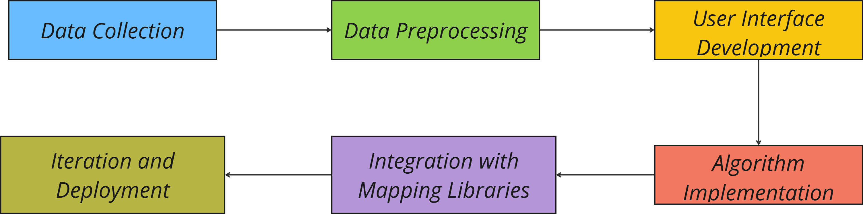
Methodology
The methodology includes collecting and preprocessing city maps, developing a user interface, implementing modified algorithms for route optimization, integrating mapping libraries for visualization, and refining the application based on feedback before deployment.

Slide 7
Tools and Technologies
• Programming Languages: JavaScript
• Front-End Development: Jquery, HTML, CSS
• Mapping and Visualization: Google Maps API, Downloaded Maps and Images, Raphael.js (JS visualization)
• Algorithm Implementation: Use of path finding algorithms like A* and Djikstra’s in a modified manner.
• Version Control: Git and GitHub for version control and collaboration.

Slide 8
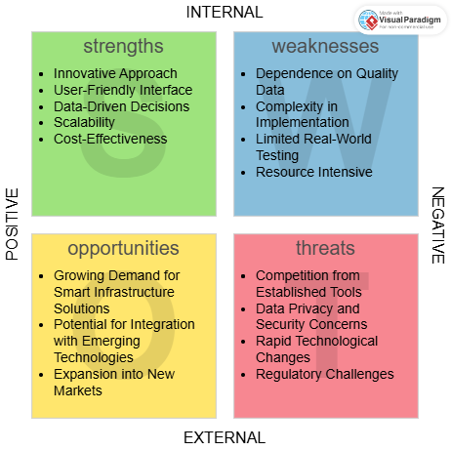
SWOT Analysis
SWOT Summary: The project leverages innovative route optimization for navigation applications, offering a user-friendly, data-driven solution. However, challenges include dependence on high-quality data and competition from established tools, which may impact its adoption and effectiveness.

Slide 9
Areas of Application
Urban Planning and Infrastructure Development
Pathfinder AI can help optimize road networks and transportation systems, reducing congestion and improving city layouts by calculating efficient routes.
Logistics and Supply Chain Management
It can optimize delivery routes, reducing costs and delivery times by determining the most efficient paths, benefiting industries like e-commerce and freight management.
Emergency Response and Disaster Management
Pathfinder AI can enable faster emergency responses by suggesting the quickest routes for ambulances, fire trucks, and rescue teams in real-time.
Geographic Information Systems (GIS) and Mapping
It can integrate with GIS to optimize pathfinding, aiding in projects like land-use planning, flood modeling, and environmental conservation.

Slide 10
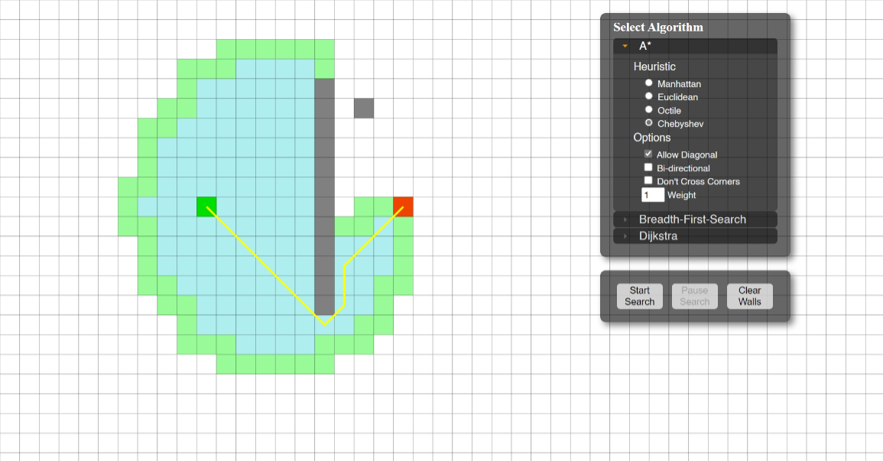
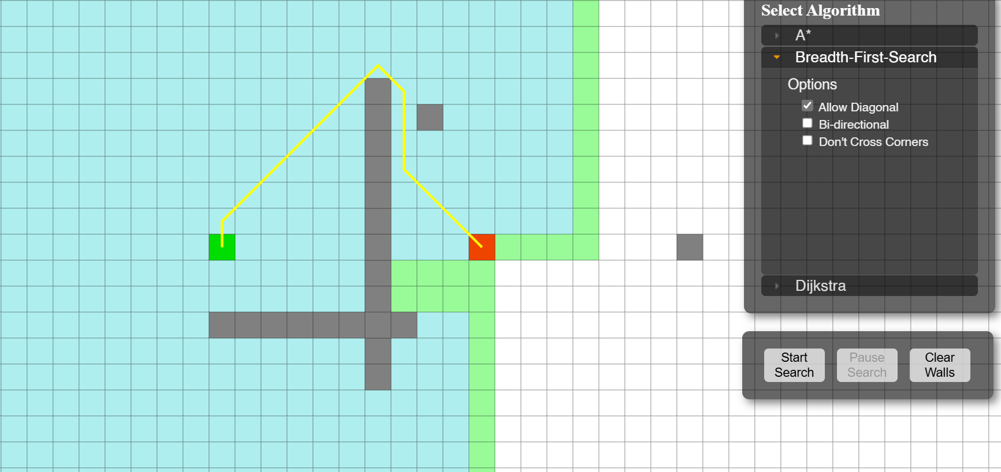
Current Progress
Developed a basic visualizer for Dijkstra and A* algorithms, allowing users to see the pathfinding processes in action. The visualizer provides a step-by-step representation of how each algorithm traverses nodes to identify the optimal route between selected points on the map

Slide 11
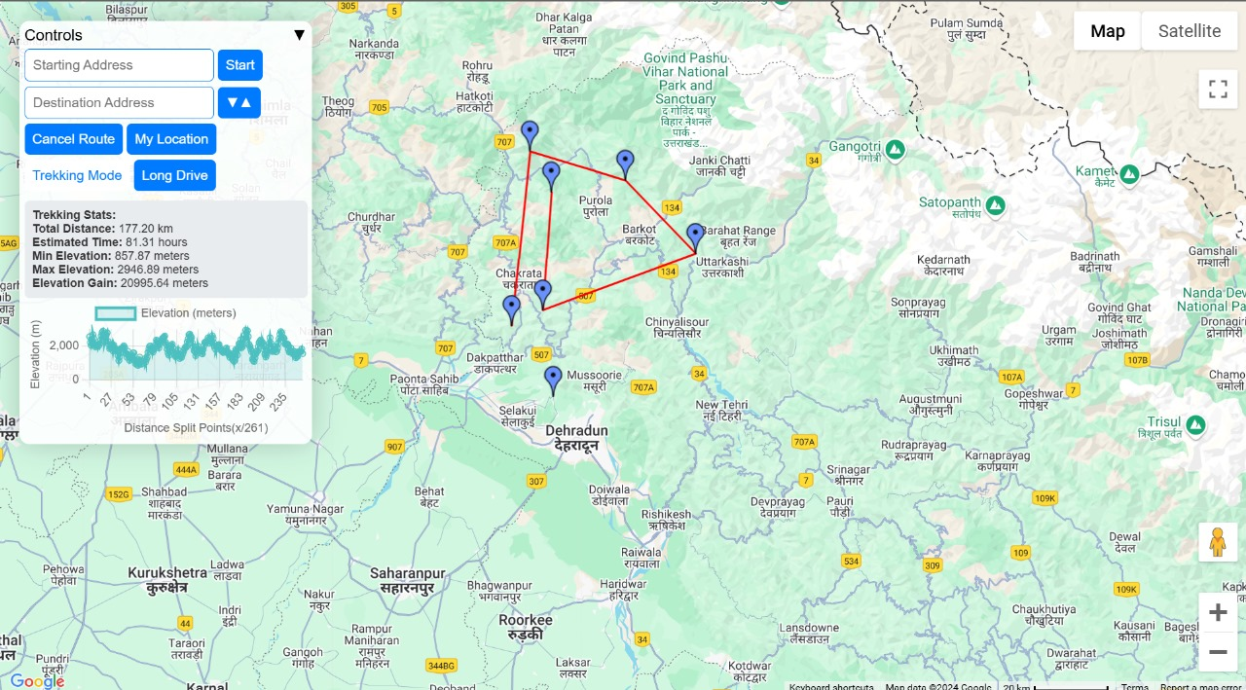
Current Progress
Developed a user interface for the project using OpenStreetMap (OSM) as the primary map platform. This interface allows users to interact with a city-wide map, where they can select cities to connect and mark essential landmarks like hospitals, offices, government buildings, airports, and stations.

Slide 12
Achieved Deliverables
1. Integration of OpenStreetMap
Successfully integrated OpenStreetMap data into the codebase for accurate mapping and route planning.
2. Straight Distance Mapping Feature
Implemented the ability to calculate and display straight-line distance between selected points on the map.
3. Algorithm Implementation
Applied and integrated the following algorithms:
Dijkstra’s Algorithm
A Algorithm*
Breadth-First Search (BFS)
for efficient pathfinding and route optimization.
4. Algorithm Visualization
Developed visualizations for the implemented algorithms, aiding in better understanding and analysis of algorithmic processes on map datapoints.
5. Map DataPoint Integration
Implemented functionality to apply pathfinding algorithms to specific map datapoints, allowing users to visualize optimal routes on a map.
6. User Interaction Features
Developed user interface features to allow users to interact with the map, select points, and visualize paths computed by the algorithms.
7. Efficient Visualization for Algorithm Comparison
Created an effective platform to compare the performance and results of different pathfinding algorithms through visual representation on the map.

Slide 13
Planned Improvements
1. User Signup Functionality
Implement a user registration and login system to allow personalized experiences and user-specific data management.
2. User Interface (UI) Improvements
Enhance the design and usability of the interface, making it more intuitive, responsive, and visually appealing.
3. Curved Path Implementation Using Bézier Curves
Introduce the ability to visualize curved paths by utilizing Bézier curves for smoother and more realistic route representations.
4. Control Points for Path Customization
Add functionality to allow users to define control points, providing more flexibility in customizing and adjusting the path shapes.
5. Report Generation Functionality
Develop a feature for generating detailed reports, summarizing the chosen routes, algorithms used, and performance metrics for users to download or share.

Slide 14
References
https://docs.mapbox.com/help/glossary/mapbox-js/
Google Maps Platform. (n.d.). Google Maps API Documentation.
Project Management Institute. (2017). A Guide to the Project Management Body of Knowledge (PMBOK Guide) (6th ed.).
https://www.youtube.com/watch?v=J7eyI1ClDOA
https://www.iirs.gov.in/iirs/sites/default/files/pdf/2023/Overview_of_Remote_Sensing_and_GIS_Applications_E-Book.pdf
https://www.sciencedirect.com/journal/isprs-journal-of-photogrammetry-and-remote-sensing

